Slide 1
Basic Biological Concepts
Lecture 3 – Cell Biology
BIO 10 – Spring 2020

Slide 2
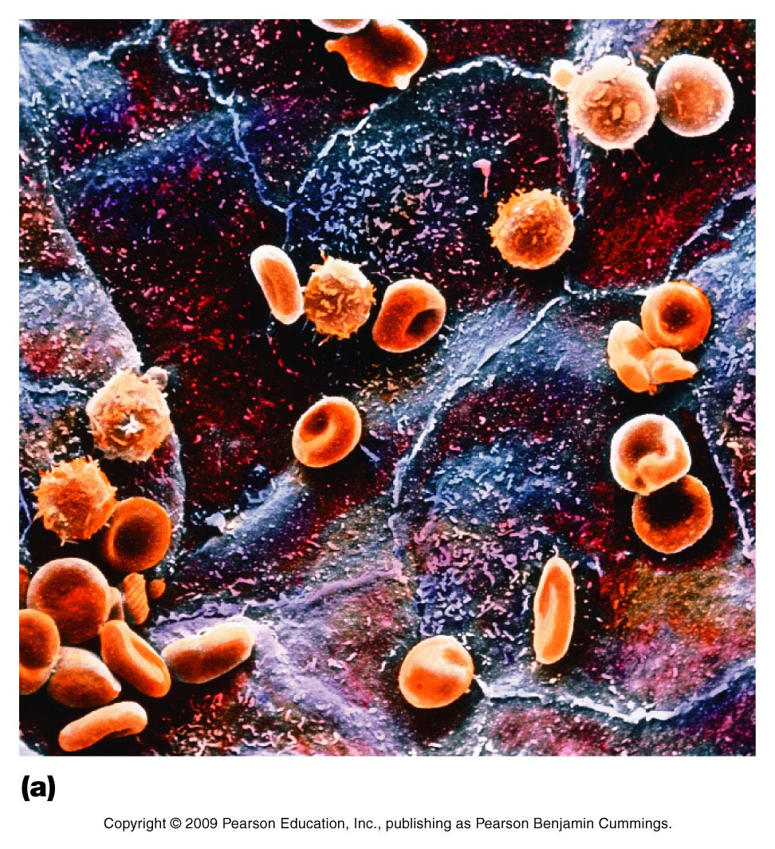
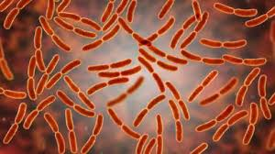
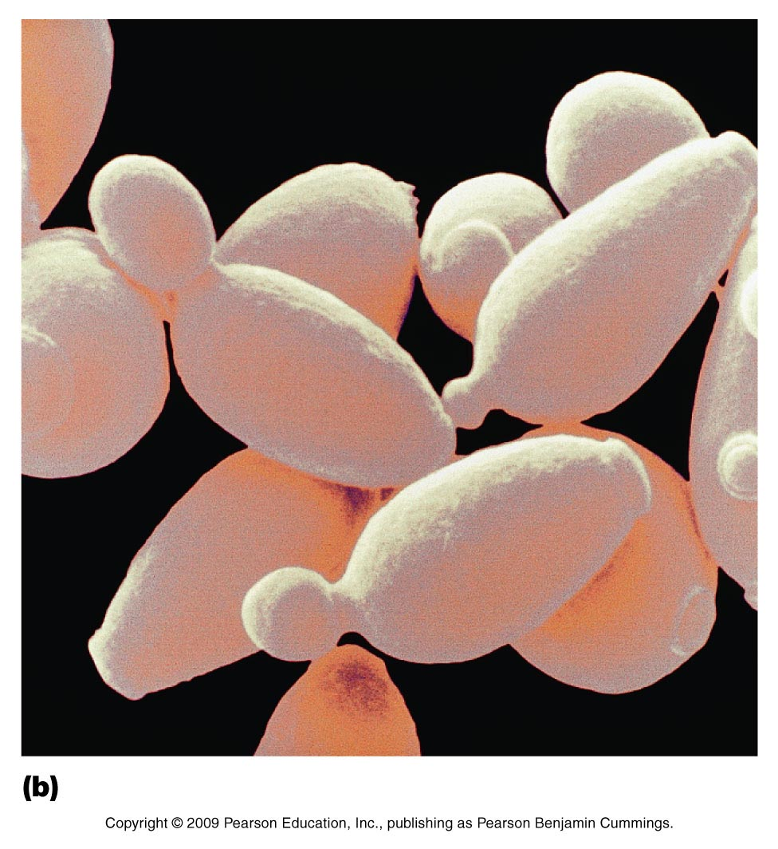
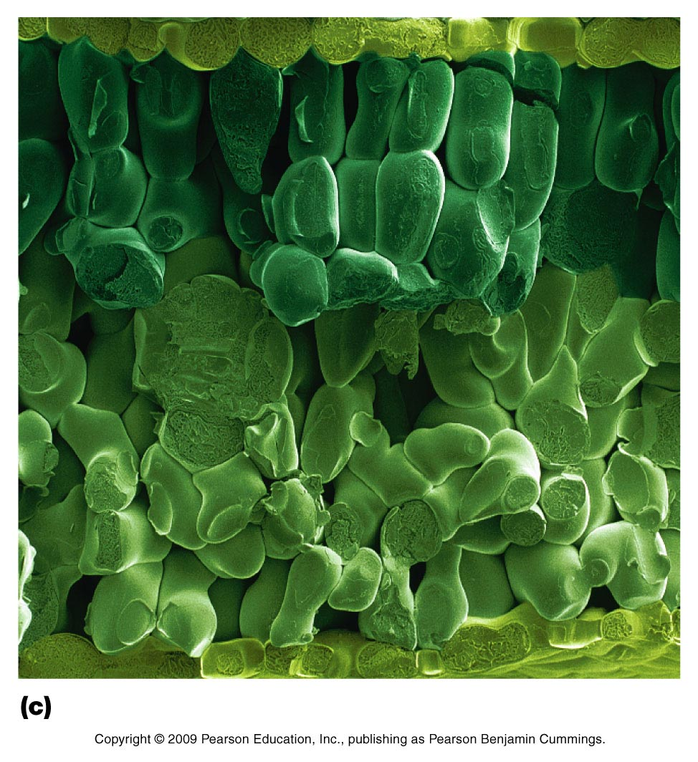
White blood cell
Red blood cell
Rod-shaped bacteria
Epithelial cell (flat)
Brewer’s yeast cells
Spinach leaf cells

Slide 3
The Cell is the Fundamental Unit of Life
Every form of life on Earth either is a cell or is composed of cells (viruses are a possible exception)
All cells exist in aqueous environment – water outside, water inside
Cell membranes are thin, fatty layers that keep the water phases separate from each other
Cells come from other cells (after the first ones appeared on the planet 4 billion years ago)

Slide 4
There are two basic cell types on Earth:
Prokaryotic – “before nucleus”
Includes bacteria and archaea
Small, simple cells, rapidly dividing, adaptable
Individual cells are expendable
Eukaryotic – “true nucleus”
Includes protists, plants, fungi, and animals
Large, complex cells with internal membranes
Multicellularity provides individual protections

Slide 5
Fundamental Cell Biology:
A highly active plasma membrane surrounds the cytosol
Signaling systems allow communication with other cells and the environment
In Eukaryotes, multiple membrane-bound organelles are regulated by an endomembrane system
A internal cell skeleton, or cytoskeleton, allows movement of materials and entire cells when needed
Genetic information in the form of double-stranded DNA encodes all of the organisms’ functions
Reproduction of cells requires a highly organized cell division process that includes exact DNA copying

Slide 6
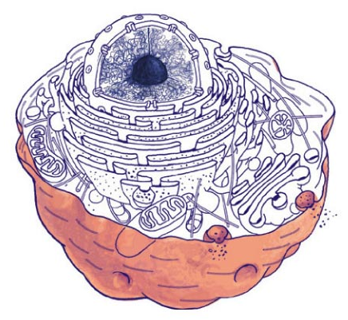
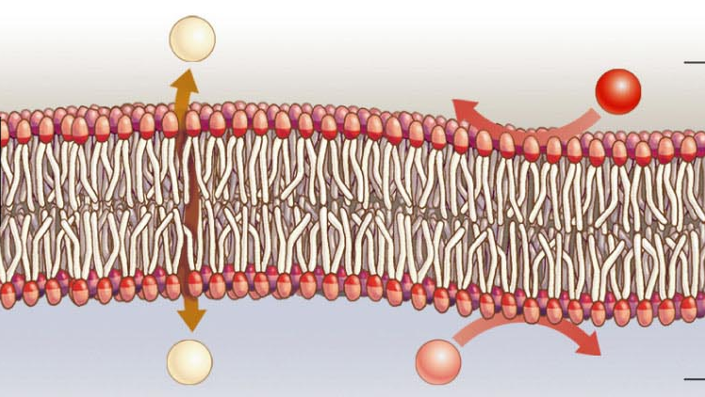
1. The Plasma Membrane
The plasma membrane is the outer lining of the cell
Membranes are ‘oily’, flexible, and chemically active
Serve as barriers to control movement of substances from one side to the other

Slide 7
The Cytosol
The cytosol is the jelly-like fluid inside the cell
The cytosol in prokaryotic cells is mostly water but also contains ions, and free-floating molecules (sugars, proteins, etc.)
The cytosol of eukaryotic cells is highly organized and compartmentalized by the membrane-bound organelles and cytoskeleton

Slide 8
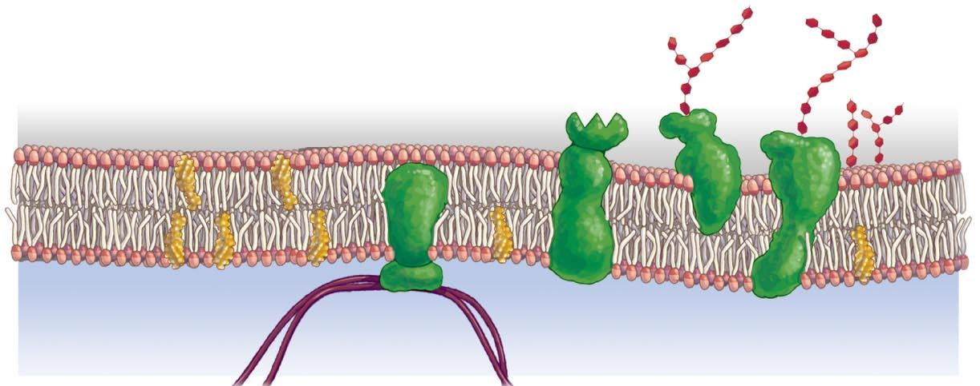
The Plasma Membrane has four main components
Phospholipid bilayer – forms a spontaneous barrier in water
Cholesterol – a steroid lipid helps with fluidity of the membrane
Proteins – provide many diverse functions to the cell membrane
Glycocalyx –sugars on outside of cell that aid in communication
glycocalyx
phospholipids
cholesterol
proteins

Slide 9
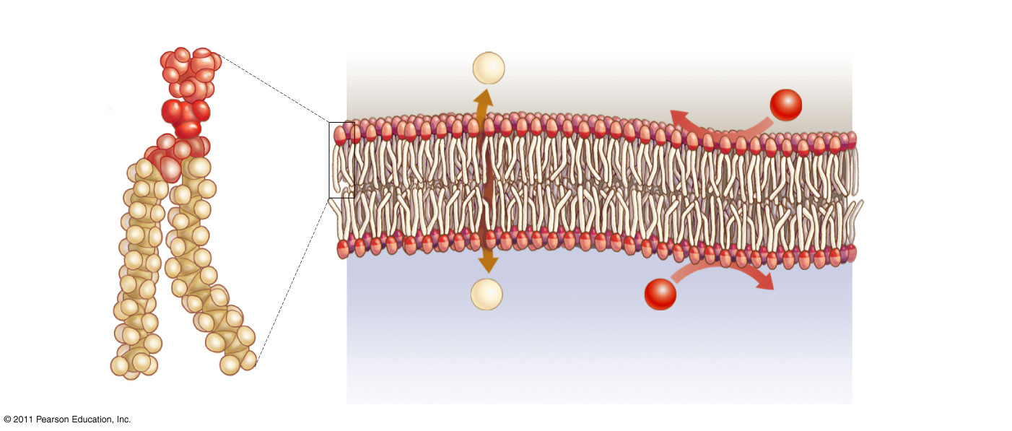
A. Phospholipid Bilayer is highly Selective
“Selects” which molecules pass through and which ones cannot!
Phospholipid
Phospholipid bilayer
watery
extracellular
fluid
Water-loving
head
hydrophilic
hydrophobic
Water-hating
tails
hydrophilic
watery
cytosol
Hydrophobic molecules can slip right through
Molecules that love water can’t pass

Slide 10
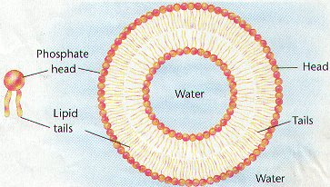
What happens when you add phospholipids into a container with water?
Heads interact with water
Tails interact with each other
Spontaneously forms bilayer!

Slide 11
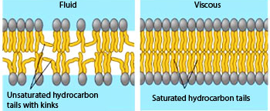
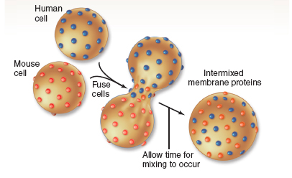
Phospholipid Bilayer is Fluid!
The type of hydrocarbon (fatty acid) in the tails of the phospholipids affects the fluidity of the membrane:
unsaturated fatty acids = fluid (loose) membrane
saturated fatty acids = viscous (harder) membrane
(double bonds)
Fluidity allows for breaking and fusing of parts of membranes without losing integrity

Slide 12
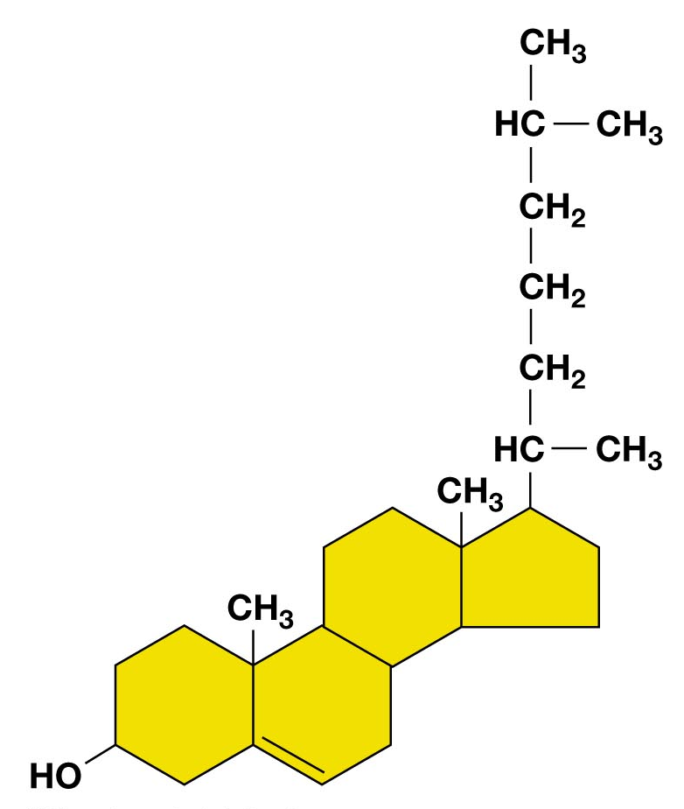
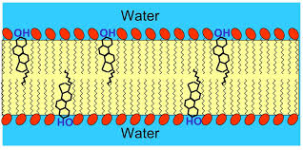
B. Cholesterol (another lipid component)
Cholesterol
hydroxyl group interacts with water
steroid
Notes:
Steroid

Slide 13
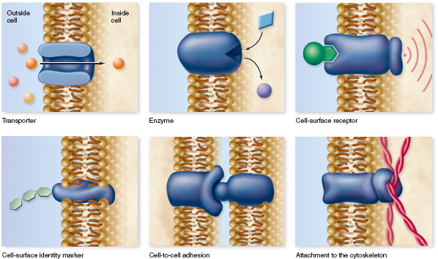
C. Types and Functions of Membrane Proteins
4
1
Transporters
Enzymes
Cell-surface receptors
Cell-surface identity markers
Cell-to-cell adhesion proteins
Attachments to the cytoskeleton
See next slide for descriptions
5
2
6
3

Slide 14
Functions of Membrane Proteins
Transporters – channels or carriers that move materials across the membrane
Enzymes – carry out chemical reactions on the interior surface of the plasma membrane
Cell-surface receptors – receptor proteins that detect chemical messages
Cell-surface identity markers – identify cells to other cells (ID tags)
Cell-to-cell adhesion proteins – glue one cell to another
Attachments to the cytoskeleton – anchored to the cytoskeleton and provide structure to the cell

Slide 15
D. The sugars of the Glycocalyx are attached to membrane proteins (occasionally lipids) and aid in:
Signal reception
Cell identity
Attachments to other cells
Attachments to the cytoskeleton
They increase the uniqueness of each location they are found on.

Slide 16
Most organisms also have protective cell walls
Orange: have cell walls
Purple: no cell walls
Cells
Prokaryotic
Eukaryotic
Protists
Bacteria
Archaea
Fungi
Animals
Plants
Animal cells are protected and need flexibility for movement

Slide 17
The Cell Wall
The cell wall is a strong rigid structure that surrounds the plasma membrane.
Different cells construct them from different molecules
Provides support for growth
Protects against predators and environmental insults
Cell wall
cytosol
Plasma membrane

Slide 18
2. Signaling systems
Signals: Hormones, growth factors, neurotransmitters,
environmental chemicals
Receptors: Every signal has a structurally-matched
receptor (one or more)
2nd Messengers: The genetics of each cell links a specific series of internal changes to each receptor
Target Mechanisms: Each series of internal changes is then linked by the cell to very specific actions
and the same signal can produce very different
things in different cells

Slide 19
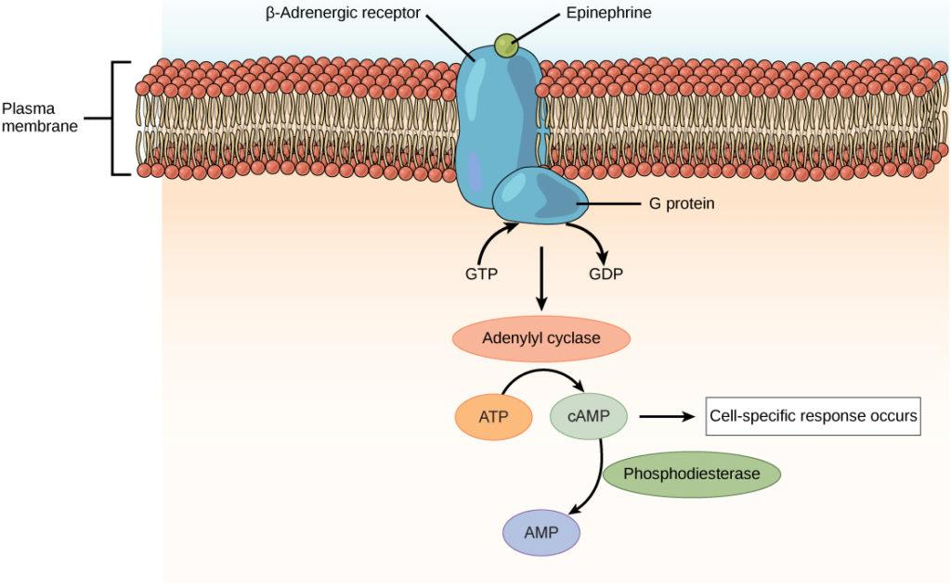
Receptors match signal molecules very closely.
Each cell type builds the second messenger cascade to do one or more specific things.

Slide 20
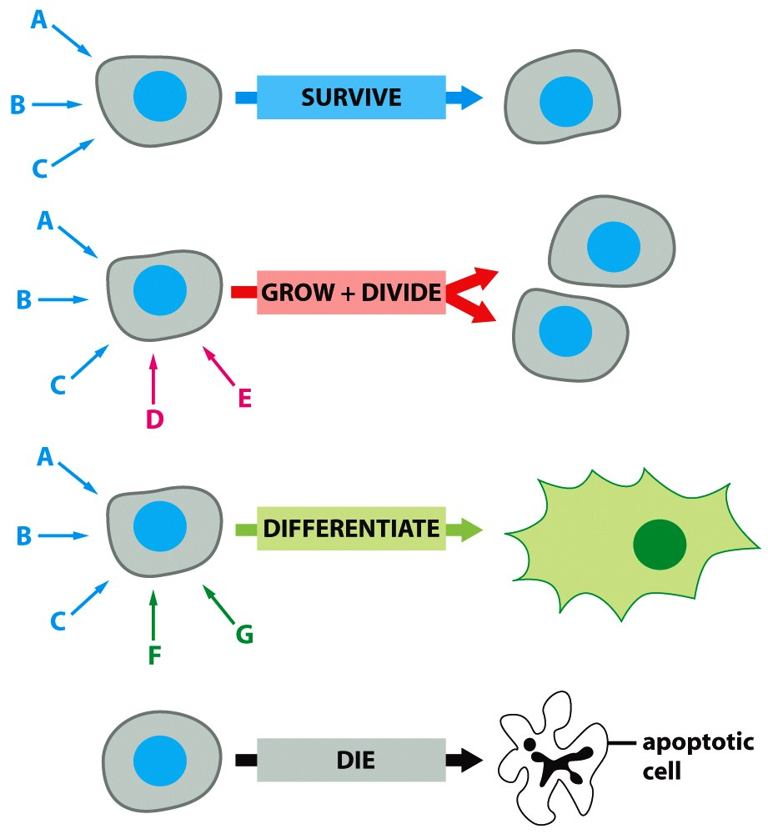
Target
Mechanisms
Cell
Number
Cell
Type
Cell
Quality
Figure 15-8 Molecular Biology of the Cell (© Garland Science 2008)

Slide 21
3. Organelles and the Endomembrane
System in Eukaryotes
Organelles – Prokaryotic cells have no membrane-bound organelles while Eukaryotic cells have many types. They are designed to keep material and activities separate in the cytosol.
The Endomembrane System – the mechanism by which eukaryotes maintain membrane separation of the content of the organelles.

Slide 22
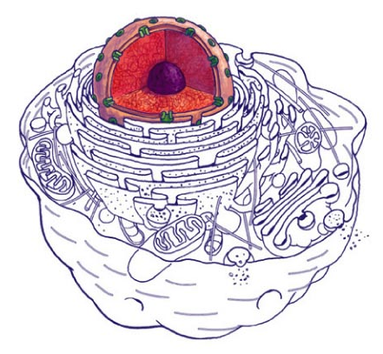
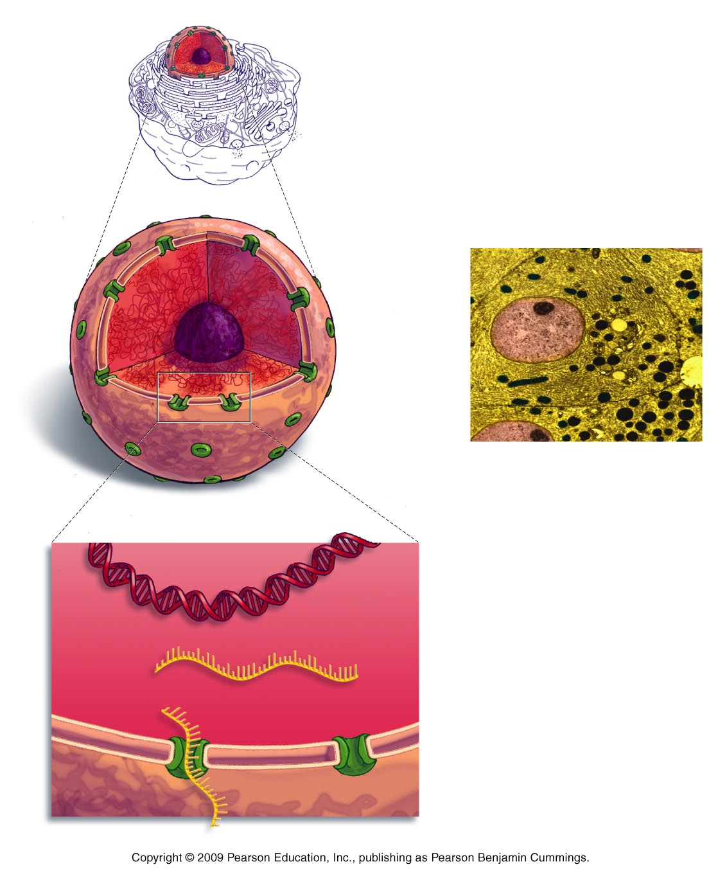
The Nucleus
The nucleus is a specialized region that contains DNA
It has two membranes surrounding it with small holes (nuclear pores) to allow material to enter and leave
Its main job is to make RNA transcripts out of DNA templates
Nucleus
DNA
RNA
Nuclear pore

Slide 23
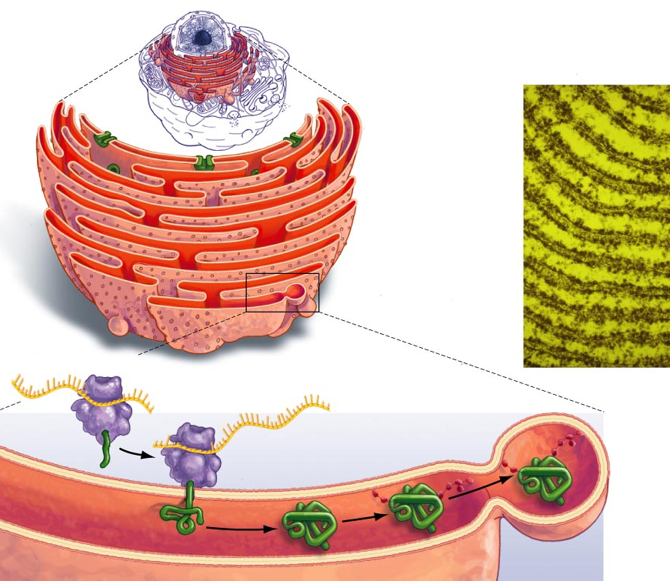
The Endoplasmic Reticulum
It is continuous with the outer membrane of the nucleus
Synthesizes new proteins and membrane lipids
Has ribosomes which translate RNA into protein

Slide 24
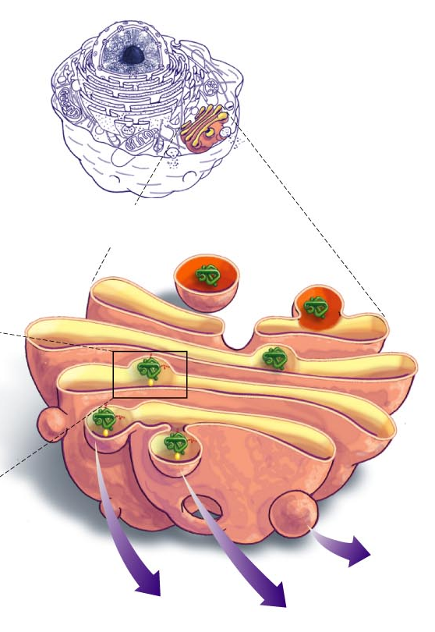
The Golgi Complex
Packages, sorts and modifies newly-made proteins and lipids
Receives lipids and proteins directly from the ER
It is called the "UPS" of the cell

Slide 25
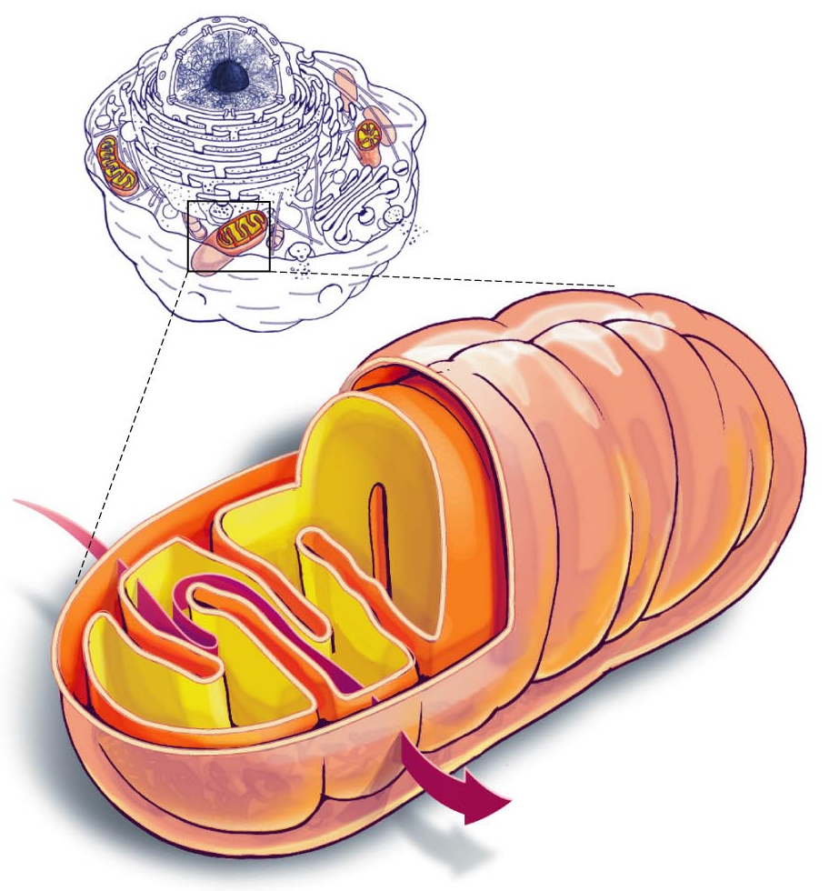
The Mitochondria
Function as the "powerhouses" of the cell
They create the energy molecule ATP from the energy stored in food
They are abundant in metabolically active cells

Slide 26
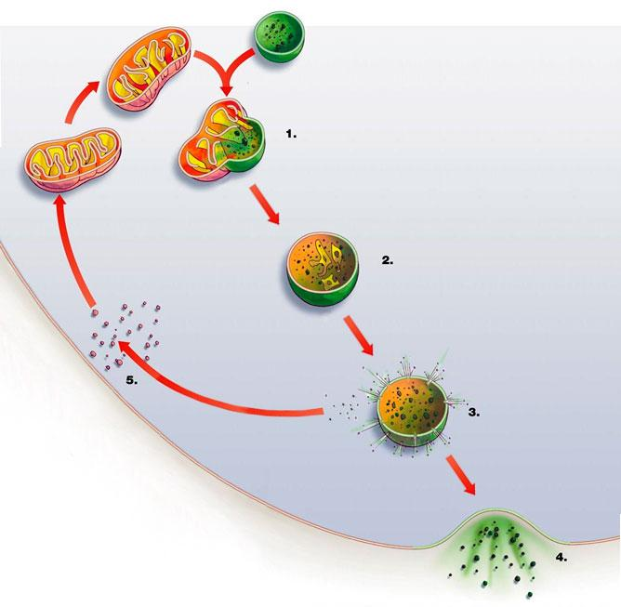
The Lysosomes
Function to breakdown and recycle organic molecules
Receive molecules both from outside and inside the cell
Contain digestive enzymes which quickly break apart molecules for recycling

Slide 27
The Vacuole
Plants typically have a large storage container organelle called a vacuole.
Stores nutrients (e.g. starch)
Stores water and minerals
Can sometimes take up nearly all of the space within the cell
vacuole

Slide 28
The Chloroplast
Chloroplasts are organelles within a plant cell that carry out photosynthesis .
Through process of photosynthesis the plants chloroplasts use sunlight energy to build sugar molecules from carbon dioxide (CO2) molecules
Chloroplast
Vacuole

Slide 29
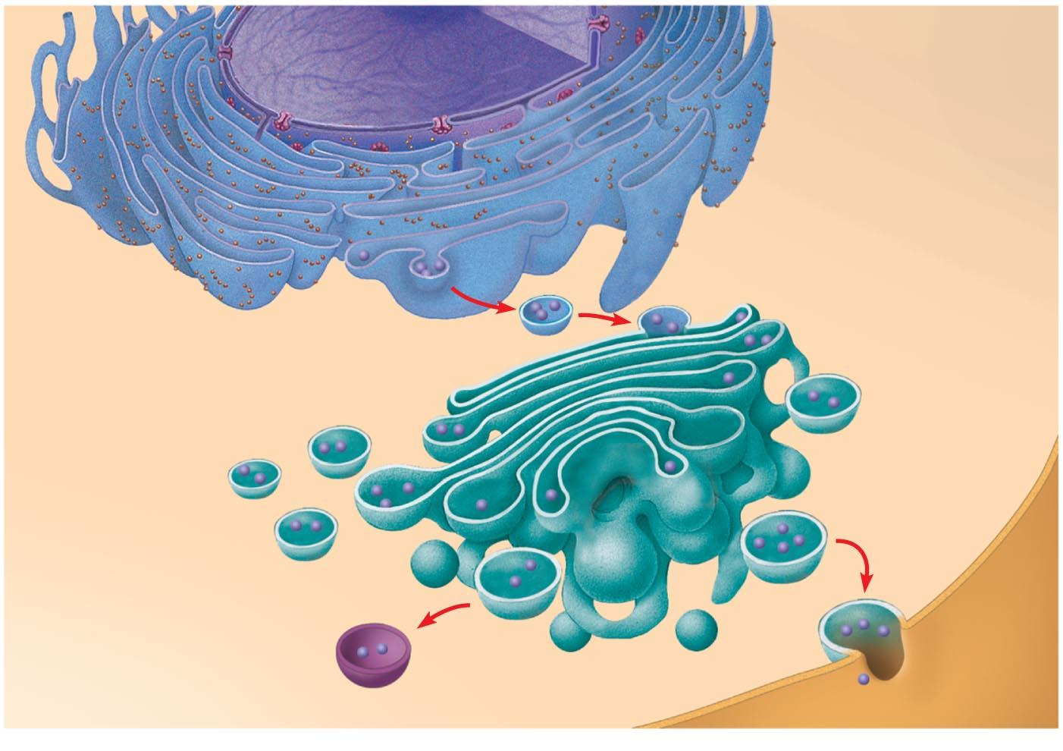
The Endomembrane System regulates the flow of material through the cytosol by keeping stuff that needs to be inside a membrane inside of one the whole time.
Nucleus
Vesicles are small membrane-bound packets that travel between organelles and the plasma membrane.
Endoplasmic Reticulum
Vesicles
Golgi
Apparatus
Vesicles
Plasma membrane
Notes:
Figure 6.16 Review: relationships among organelles of the endomembrane system

Slide 30
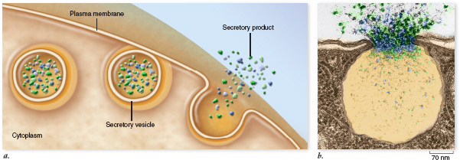
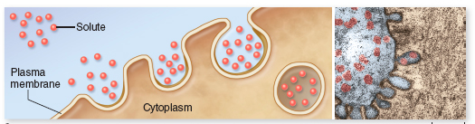
Exocytosis – moves materials outside the cell
Endocytosis – moves materials inside the cell

Slide 31
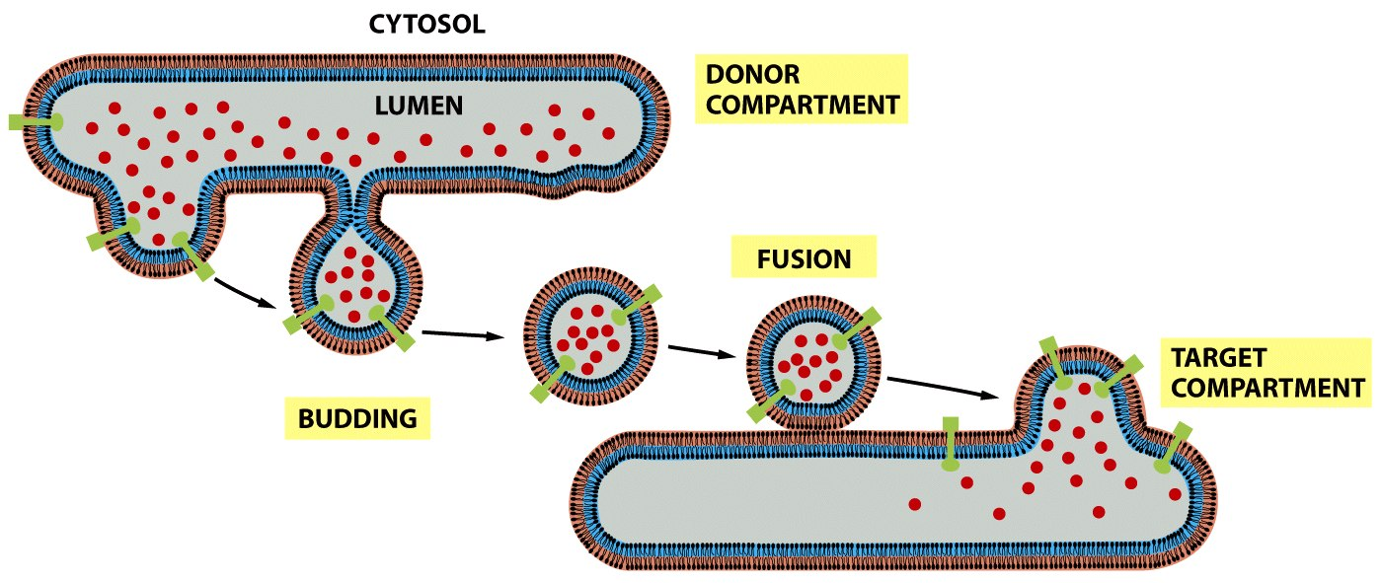
Budding and fusion of intact membrane-bound vesicles keeps contents contained

Slide 32
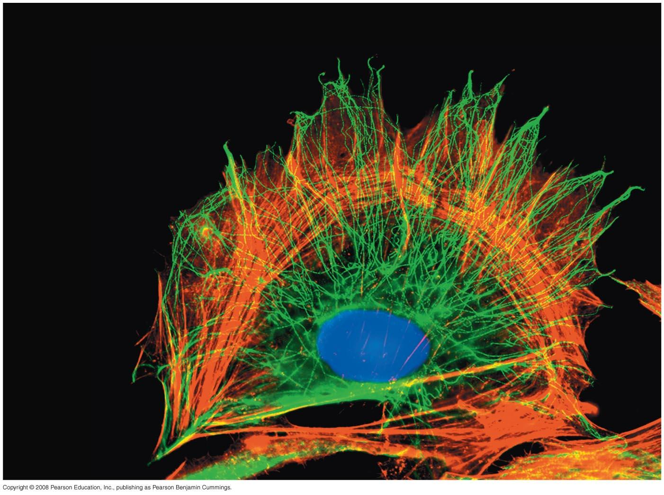
4. The Cytoskeleton
Is made of protein chains
Functions as an internal framework to give the cell its structure
Serves as a "highway" on which to transport stuff, even organelles!
Provides the framework for flagella and cilia (for movement)
Red = Actin Microfilaments
Green = Tubulin Microtubules

Slide 33
Nearly all eukaryotic cells have a 3-component cytoskeleton system:
Microfilaments (actin)
Microtubules (tubulin)
Intermediate filaments (multiple)
The first two have molecular motors that allow movement along the skeleton
Myosin
Kinesin and Dynein

Slide 34
Prokaryotes have rudimentary genetic equivalents of the first two components:
Microfilaments (actin homolog)
Microtubules (tubulin homolog)

Slide 35
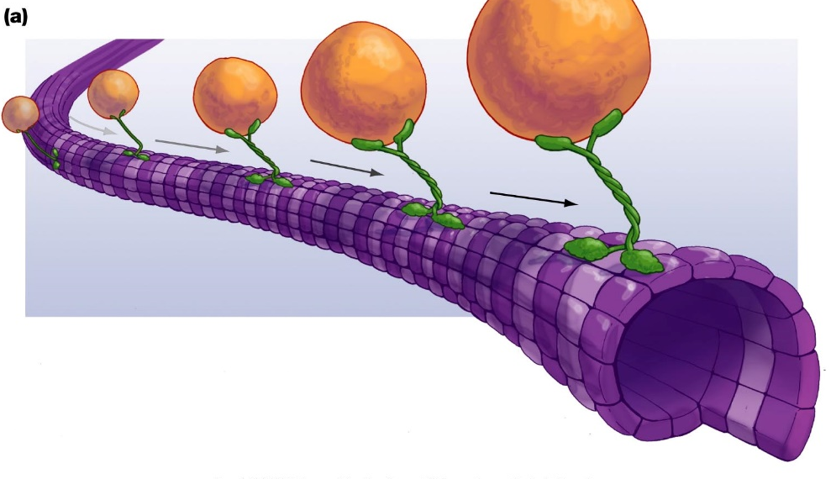
Transportation of Endomembrane Vesicles
Molecular motor proteins
Vesicle membrane proteins can bind to kinesin, dynein or myosin

Slide 36
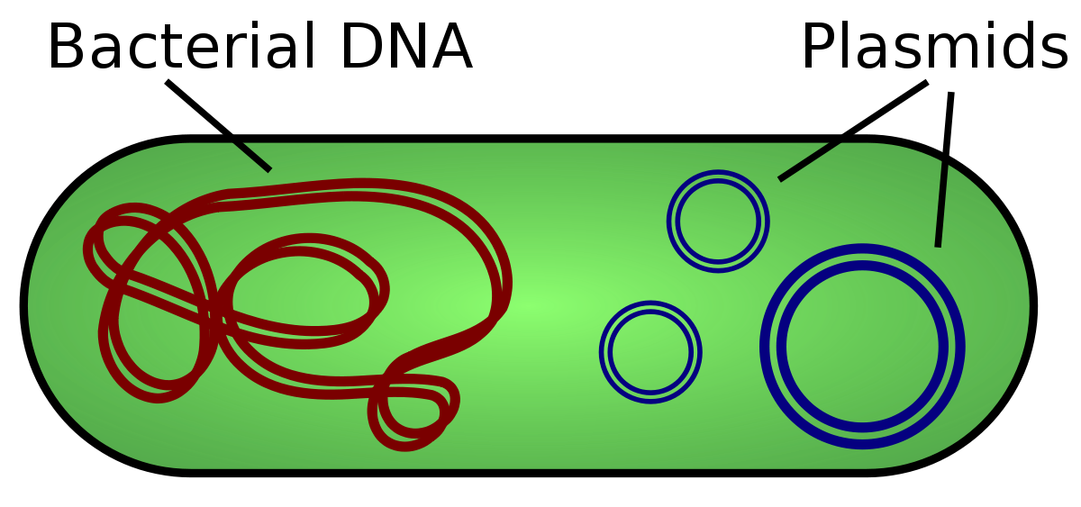
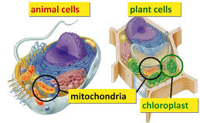
5. DNA Codes for All Cell Functions
DNA – Prokaryotic cells have a single loop of DNA while Eukaryotic cells have multiple straight strands of DNA (chromosomes) in a nucleus.
Both have additional sites which house DNA:
Prokaryotes have small circular plasmids
Eukaryotes have DNA in mitochondria, chloroplasts
Prokaryotic cells
Eukaryotic cells

Slide 37
Eukaryotic Chromosome Numbers
Lobsters 100
Dogs 78
Horses 64
Humans 46
Cats 38
Tarantulas 22
Fruit Flies 12
Oak Trees 24
Bananas 33 (3 x 11, triploid)
Wheat 42 (6 x 7, hexaploid)

Slide 38
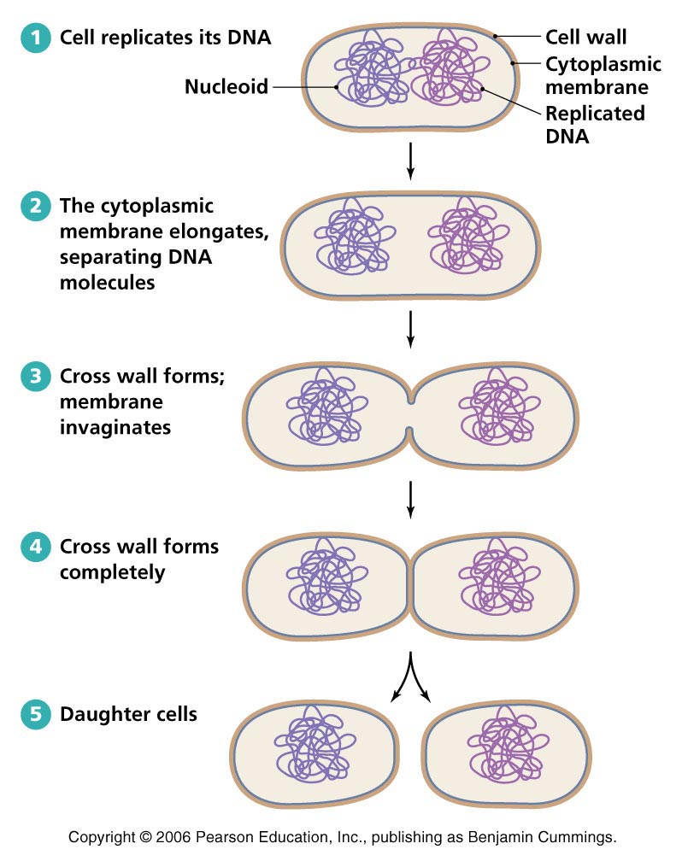
6. Cell Reproduction by Division
Binary
Fission in Prokaryotes

Slide 39
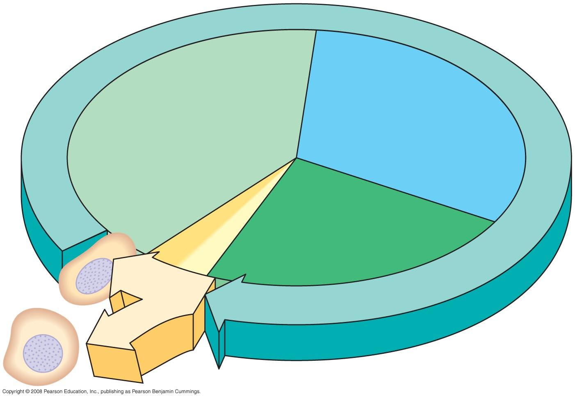
Mitotic Cell Division in Eukaryotes
INTERPHASE
G₁
S
(DNA synthesis)
Cytokinesis
G₂
Mitosis
MITOTIC
(M) PHASE
Notes:
Figure 12.5 The cell cycle

Slide 40
Interphase does the real work of mitosis
Growth Phase 1 (G₁) gets the cell ready for DNA synthesis
Need DNA synthase complexes, repair enzymes, histones, etc..
S-phase is when the cell duplicates and edits chromosomes
Synthesis and error editing are the primary objectives.
Growth Phase 2 (G₂) gets the cell ready for cell division
Need twice as many organelles, cytoskeletal proteins, molecular motors, metabolic enzymes, etc.

Slide 41
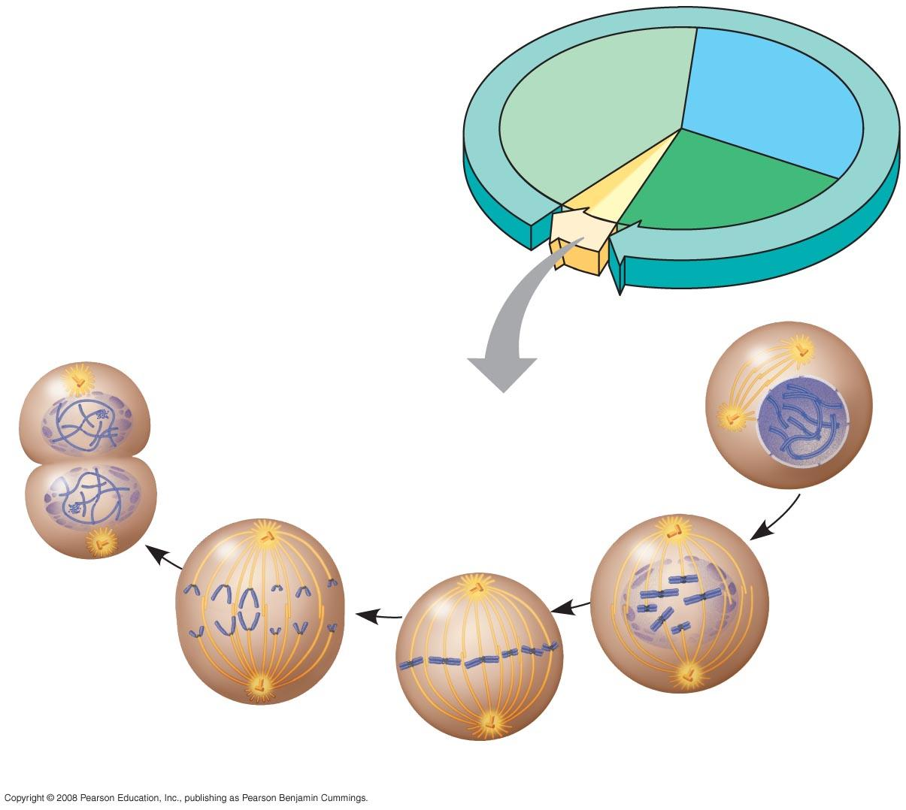
Fig. 12-UN1
INTERPHASE
G₁
S
Cytokinesis
Mitosis
G₂
MITOTIC (M) PHASE
Prophase
Telophase and
Cytokinesis
Prometaphase
Anaphase
Metaphase

Slide 42
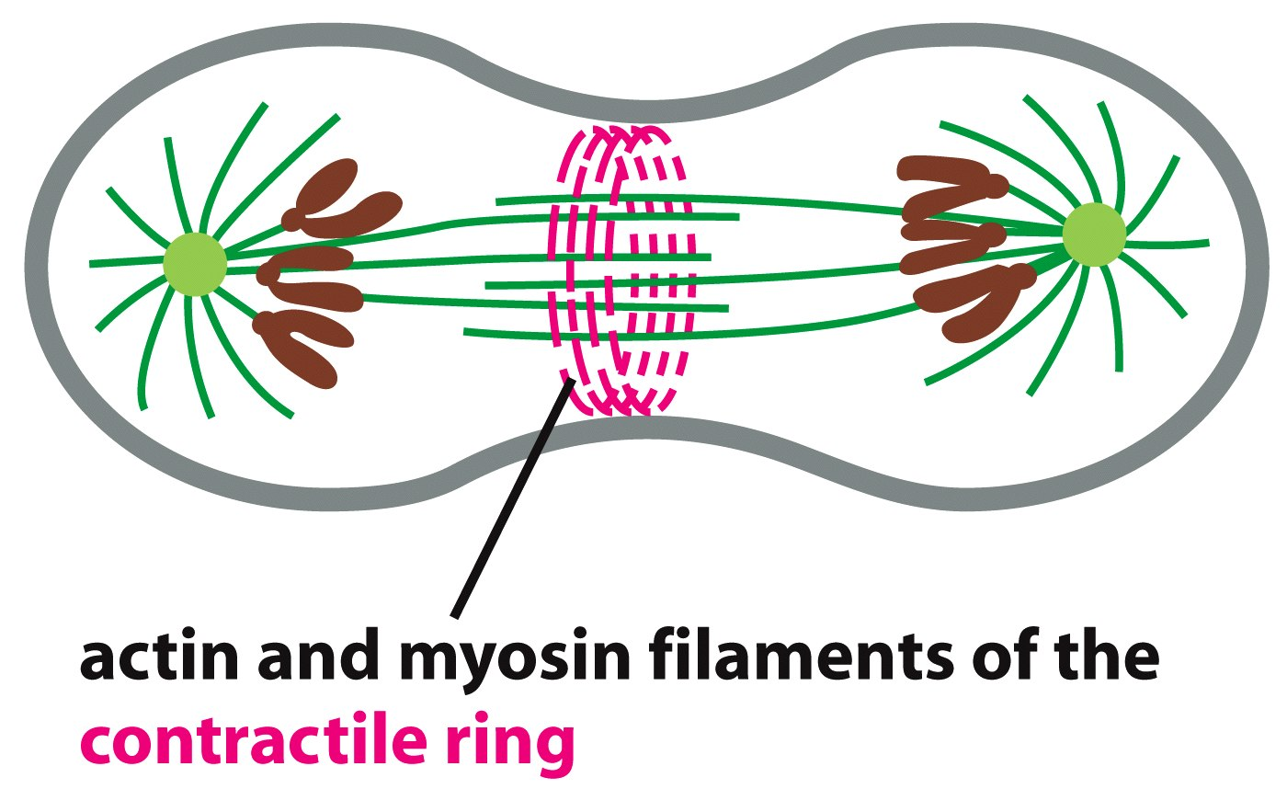
Mitotic Spindle = Tubulin and Dynein
Contractile Ring = Actin and Myosin
Separation of chromosomes (karyokinesis) results from the formation of mitotic spindles from tubulin and dynein moving chromosomes apart.
Separation into two cells (cytokinesis) results from the assembly of an actin-myosin ring that gets smaller and smaller as mysoin pulls actin along actin.

Slide 43
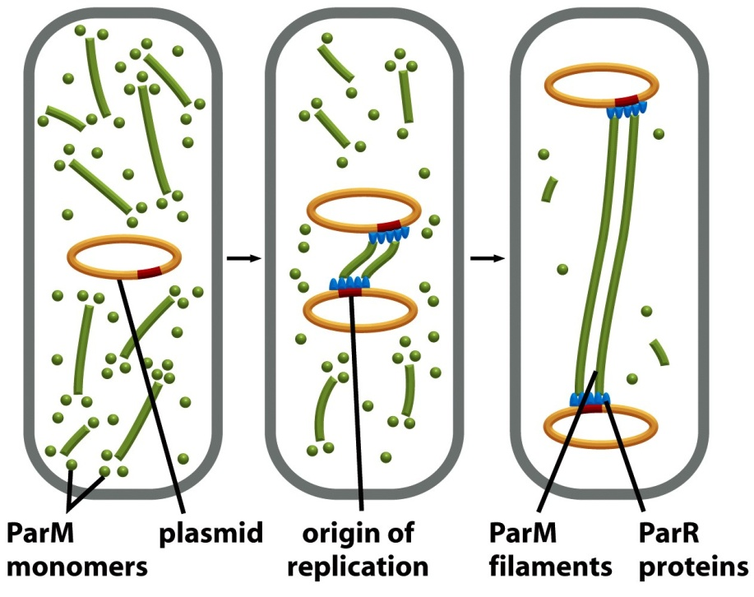
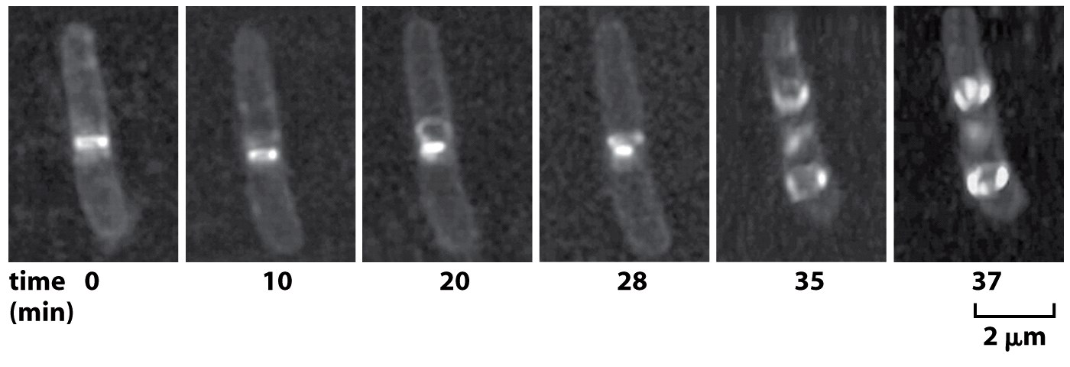
Actin homolog: ParM
Filaments elongate to separate copied chromosomes
Analogous to tubulin!
Z-ring forms and then contracts to split the daughter cells. Two rings reform in the daughters.
Analogous to actin!
Tubulin homolog: FtsZ

